Slide 1
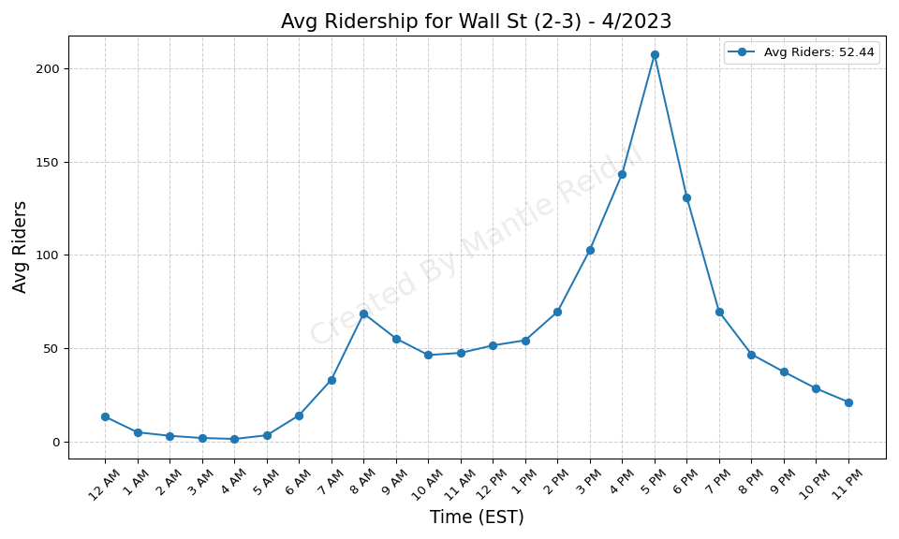
Wall St (2-3) - 4/2023

Slide 2
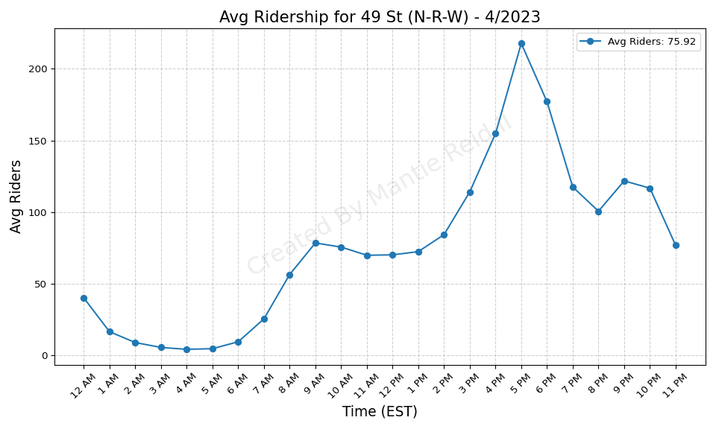
49 St (N-R-W) - 4/2023

Slide 3
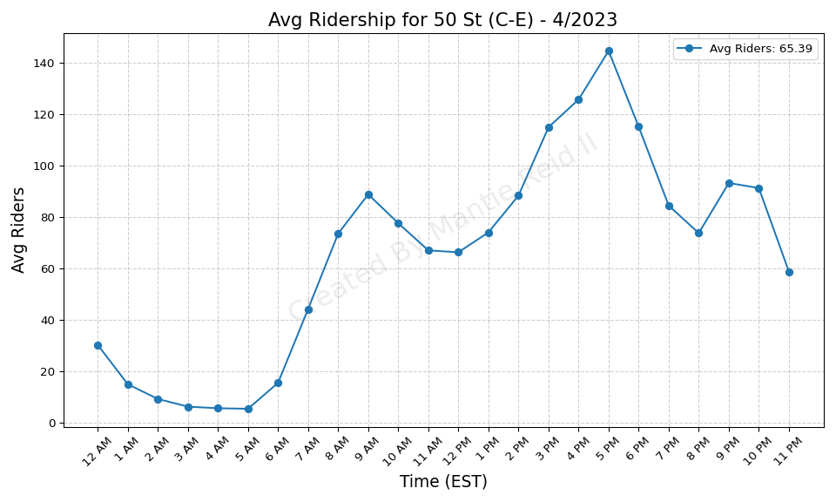
50 St (C-E) - 4/2023

Slide 4
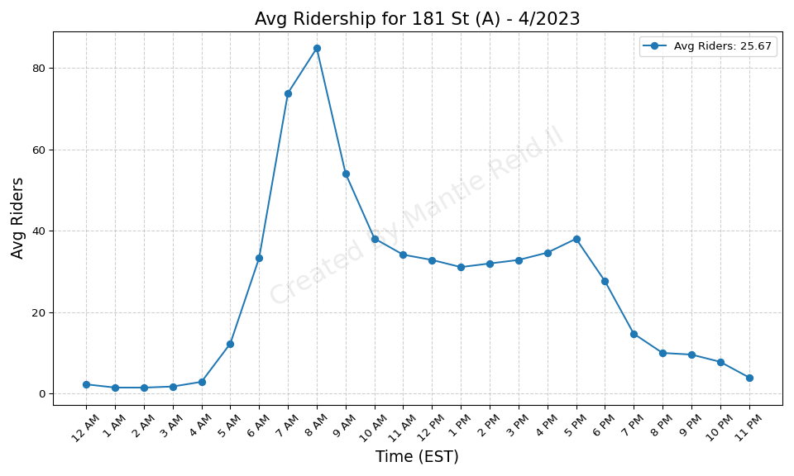
181 St (A) - 4/2023

Slide 5
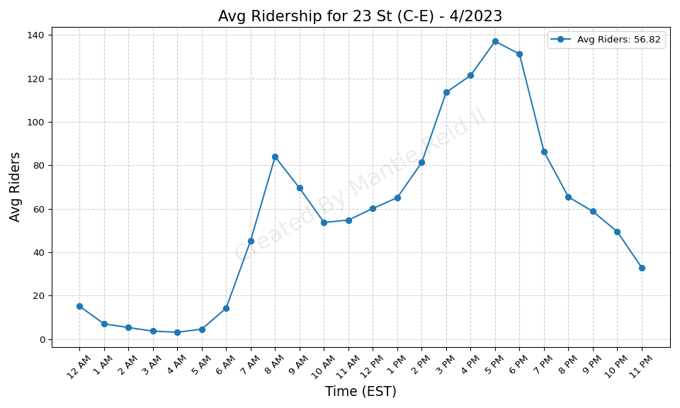
23 St (C-E) - 4/2023

Slide 6
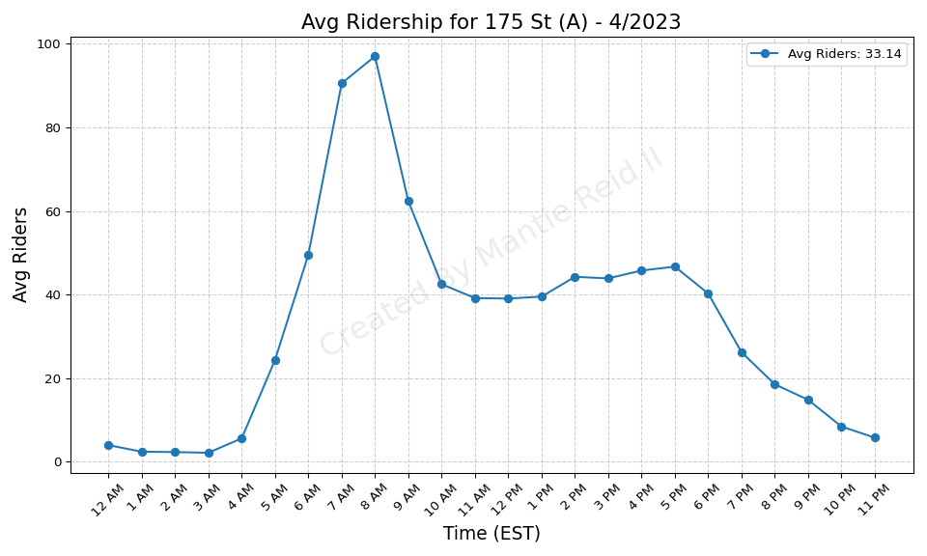
175 St (A) - 4/2023

Slide 7
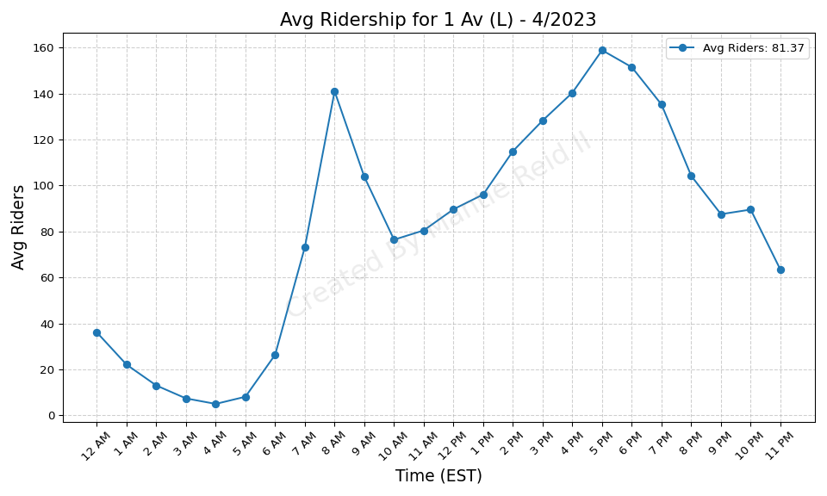
1 Av (L) - 4/2023

Slide 8
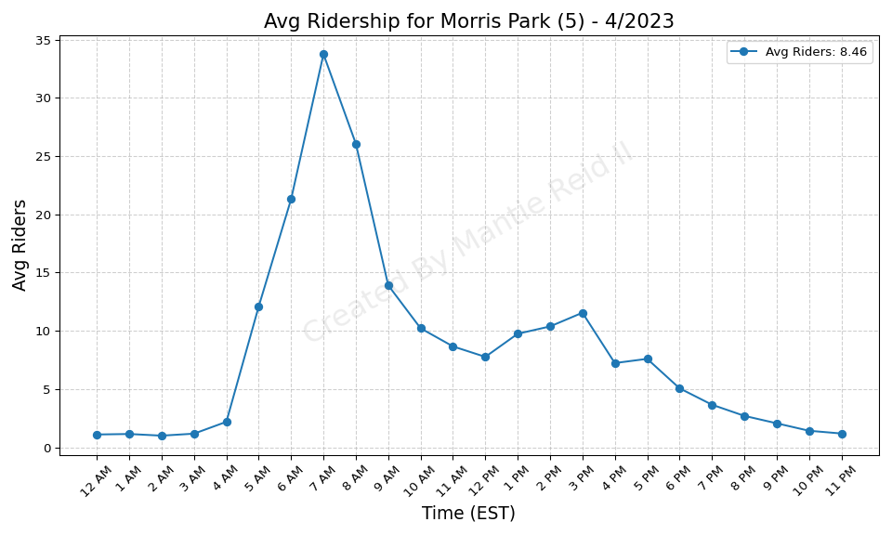
Morris Park (5) - 4/2023

Slide 9
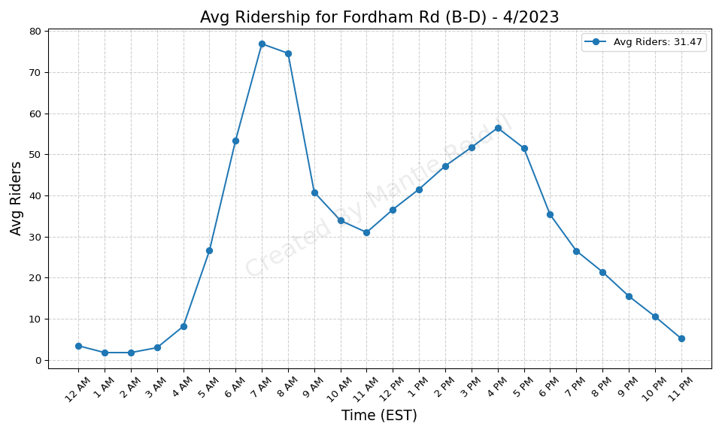
Fordham Rd (B-D) - 4/2023

Slide 10
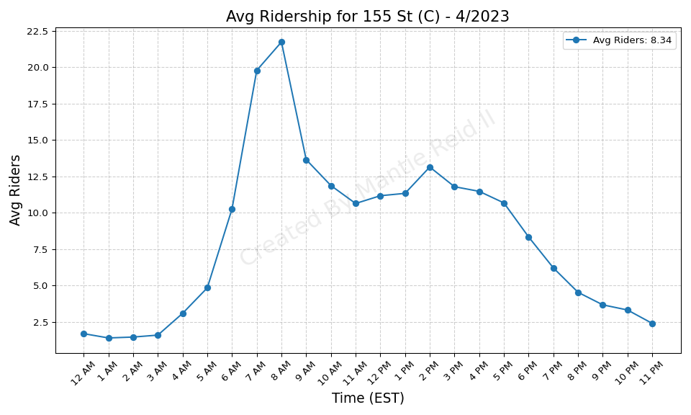
155 St (C) - 4/2023

Slide 11
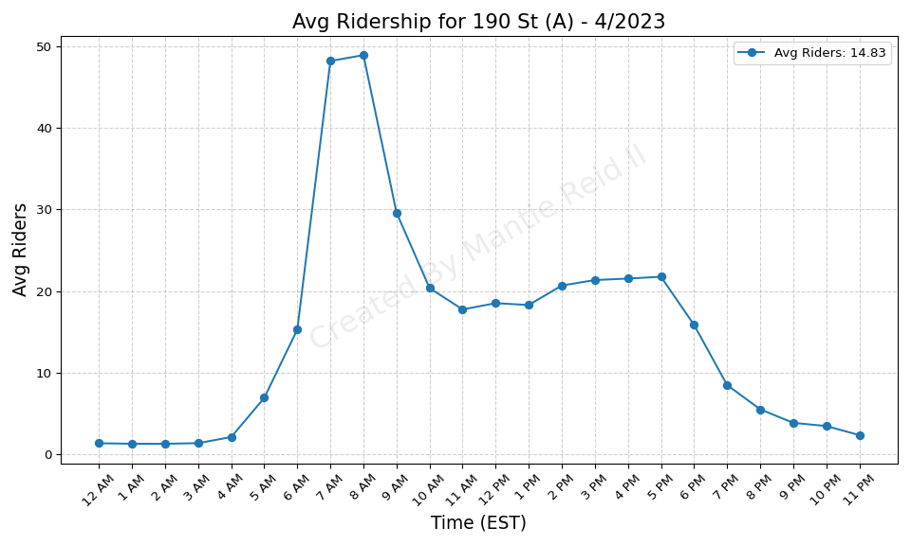
190 St (A) - 4/2023

Slide 12
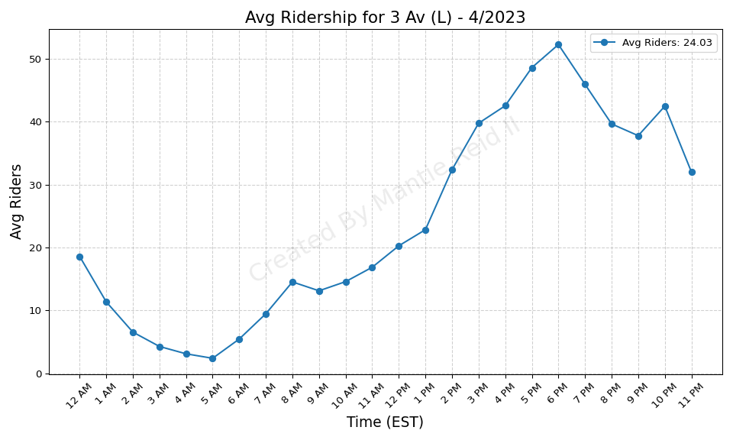
3 Av (L) - 4/2023

Slide 13
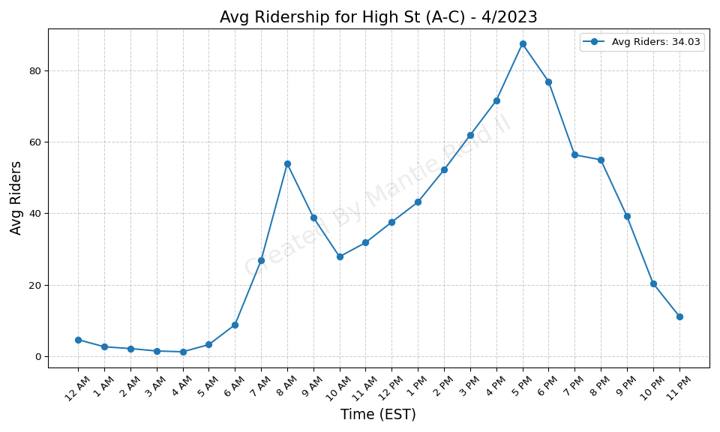
High St (A-C) - 4/2023

Slide 14
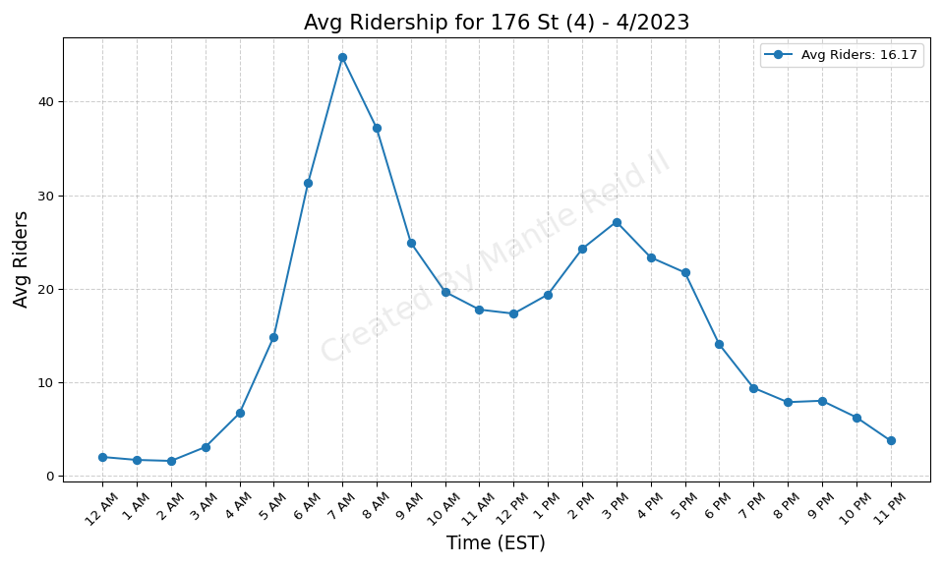
176 St (4) - 4/2023

Slide 15
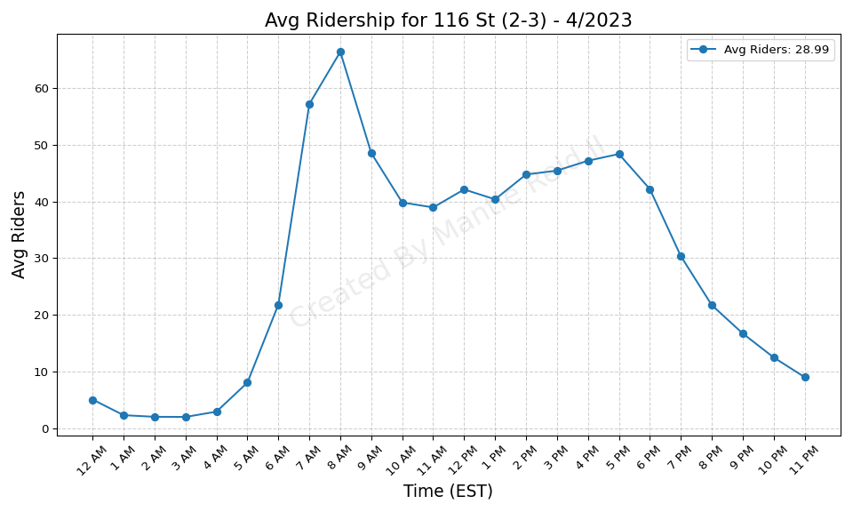
116 St (2-3) - 4/2023

Slide 16
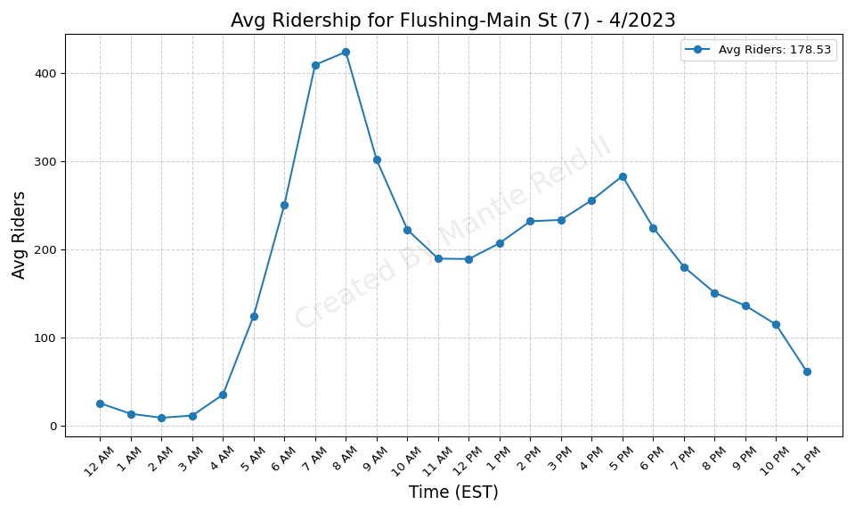
Flushing-Main St (7) - 4/2023

Slide 17
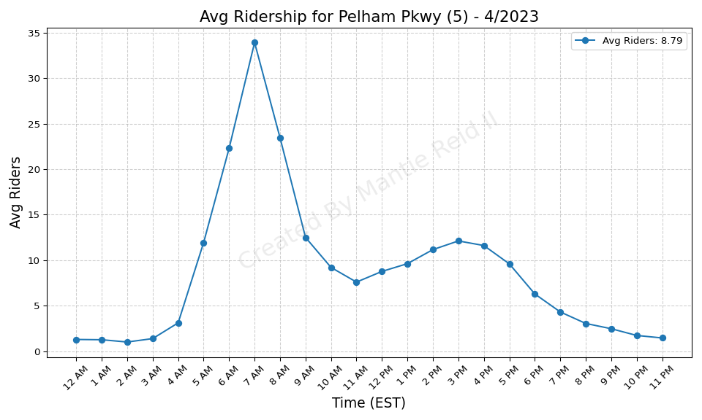
Pelham Pkwy (5) - 4/2023

Slide 18
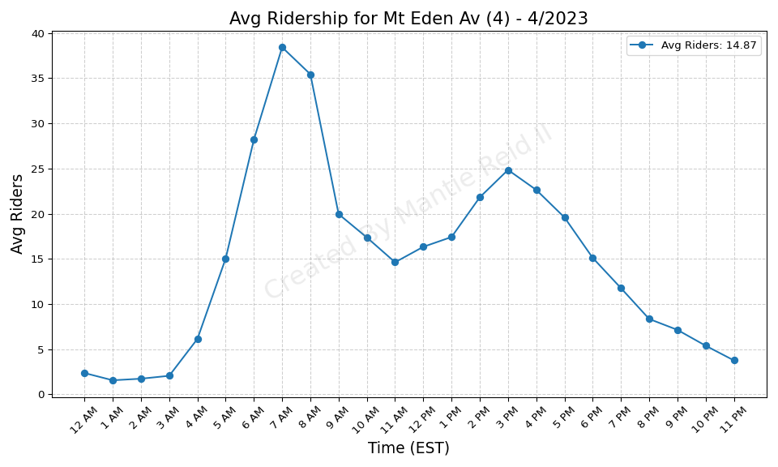
Mt Eden Av (4) - 4/2023

Slide 19
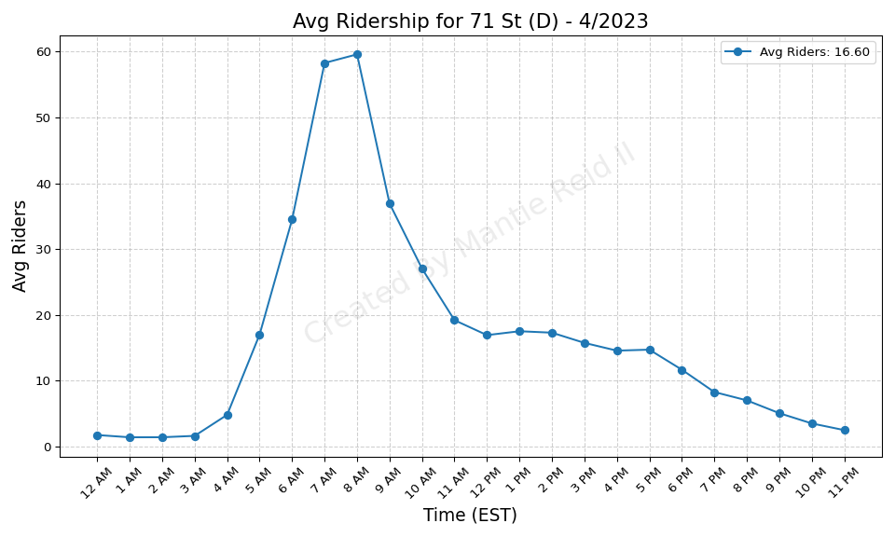
71 St (D) - 4/2023

Slide 20
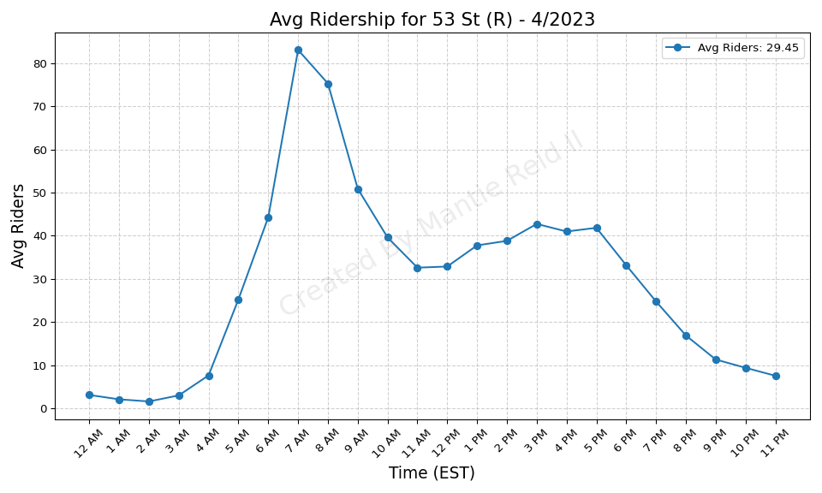
53 St (R) - 4/2023

Slide 21
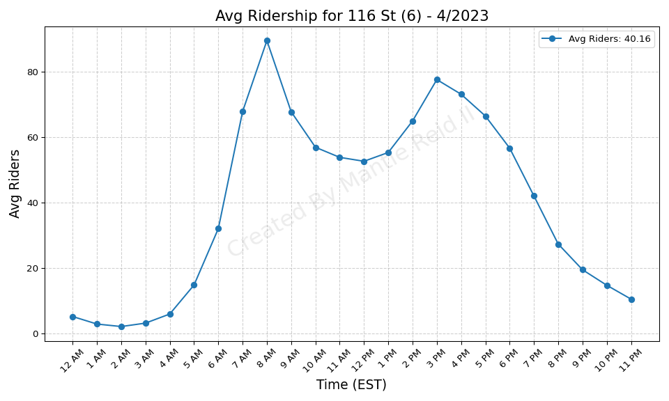
116 St (6) - 4/2023

Slide 22
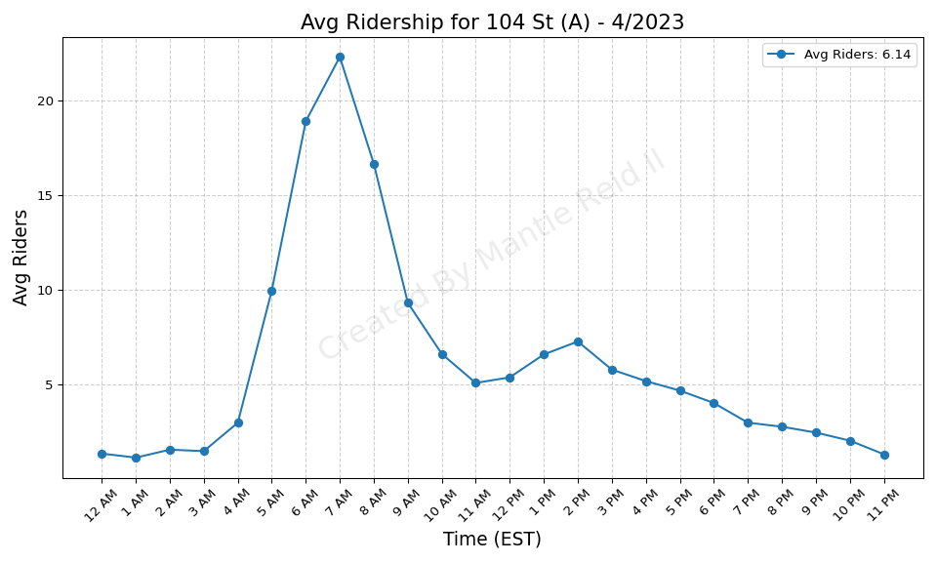
104 St (A) - 4/2023

Slide 23
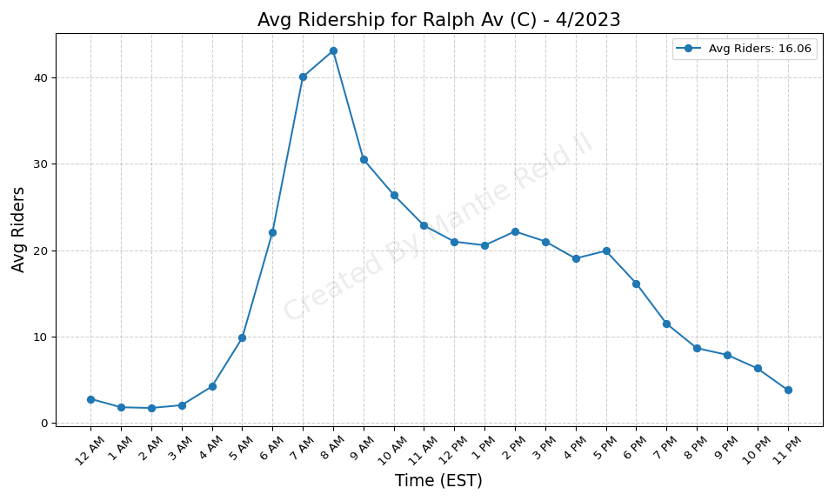
Ralph Av (C) - 4/2023

Slide 24
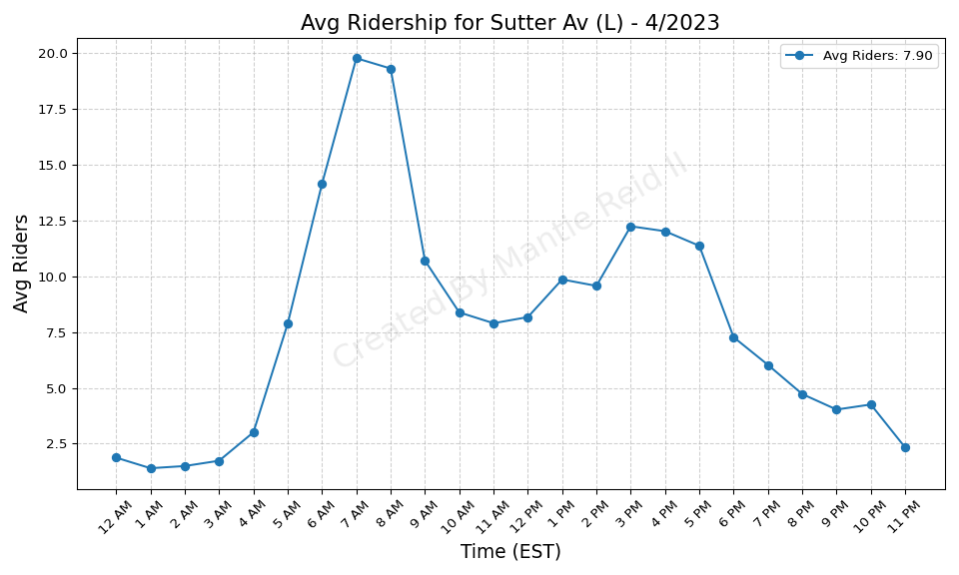
Sutter Av (L) - 4/2023

Slide 25
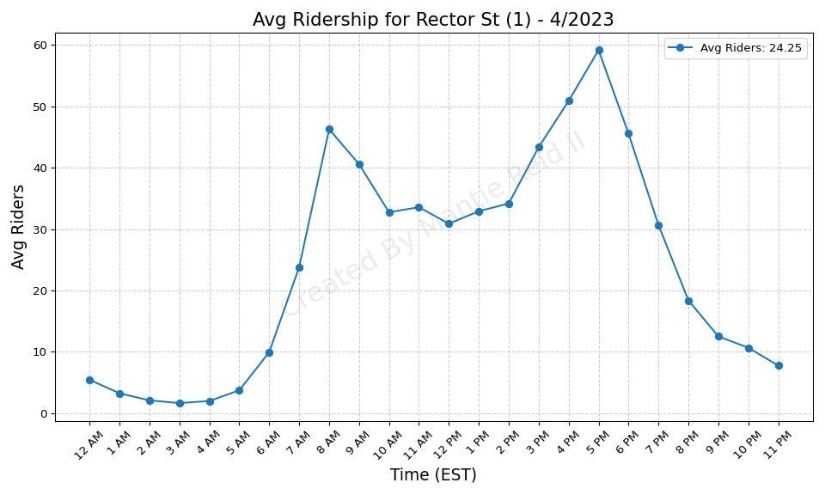
Rector St (1) - 4/2023

Slide 26
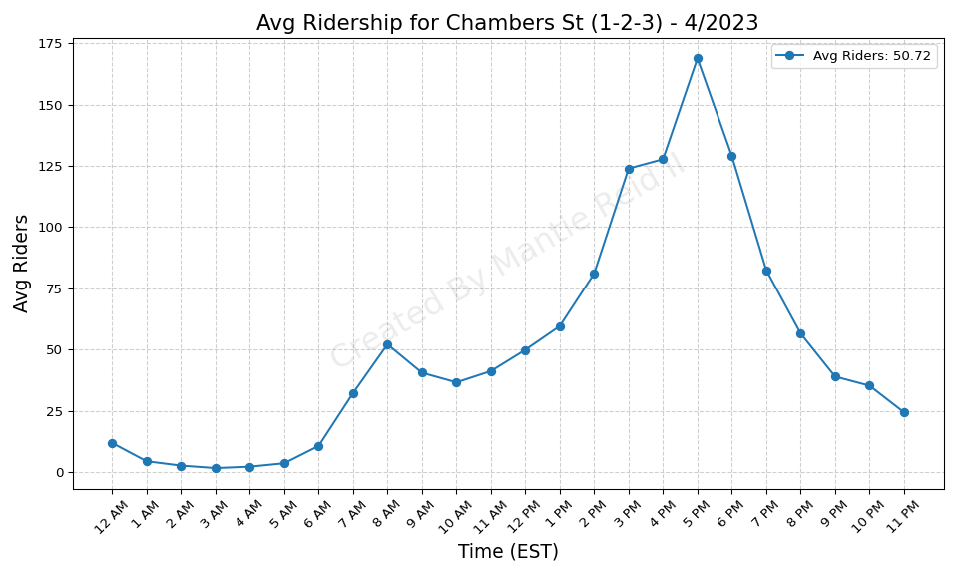
Chambers St (1-2-3) - 4/2023

Slide 27
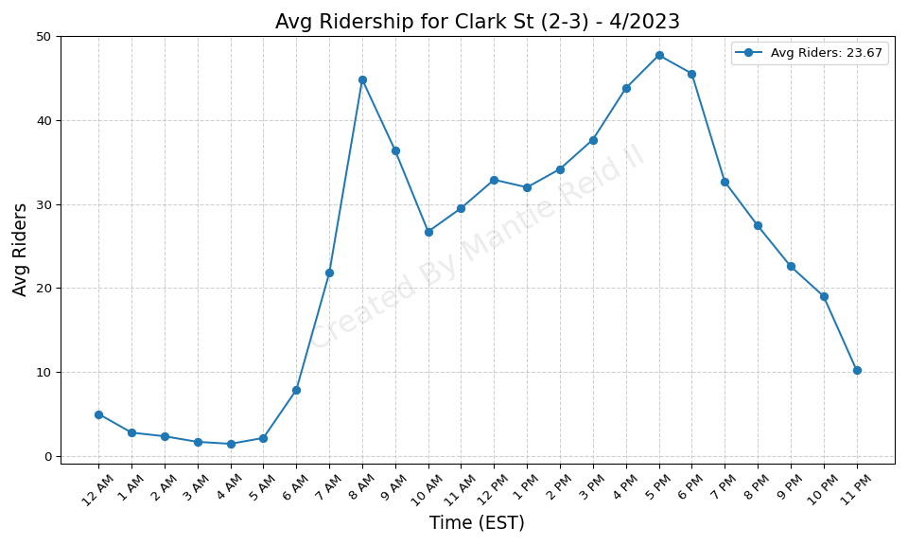
Clark St (2-3) - 4/2023

Slide 28
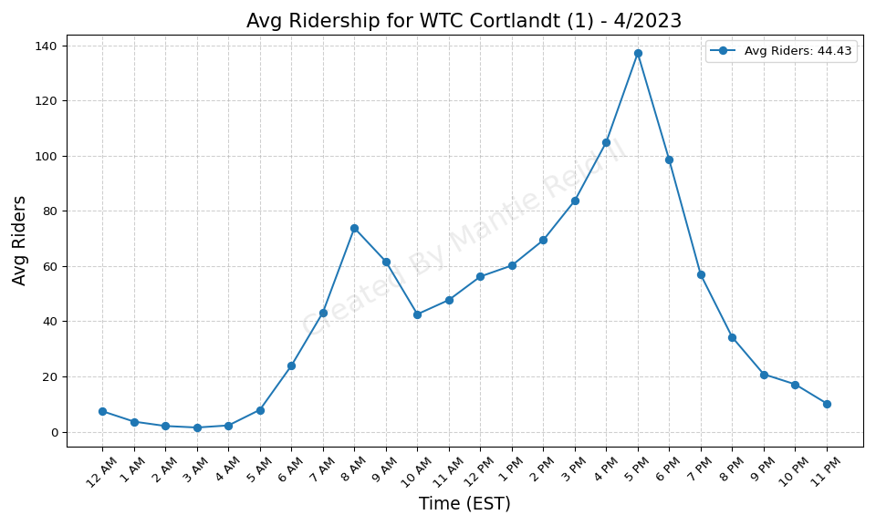
WTC Cortlandt (1) - 4/2023

Slide 29

Hoyt St (2-3) - 4/2023

Slide 30
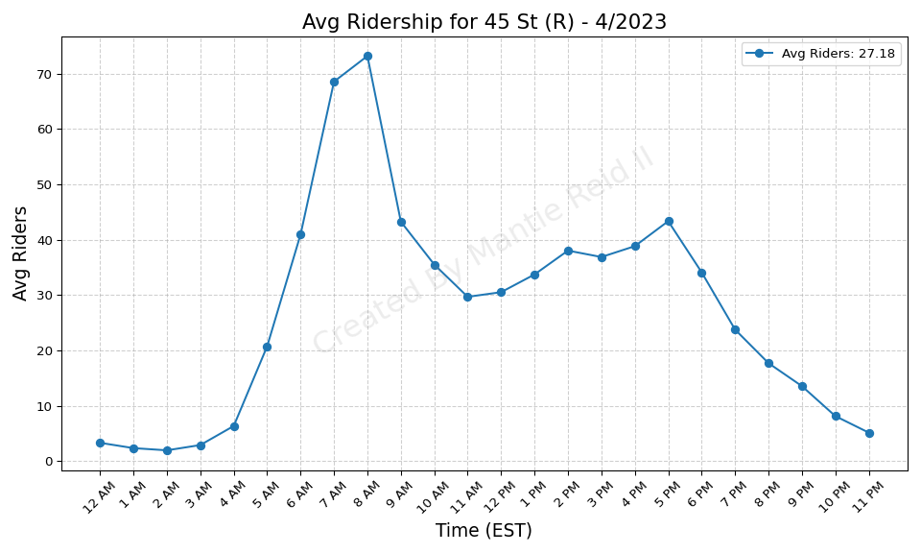
45 St (R) - 4/2023

Slide 31
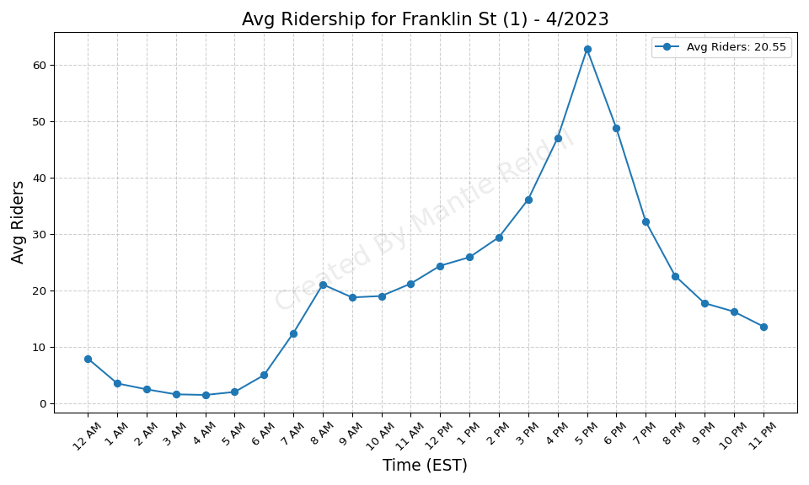
Franklin St (1) - 4/2023

Slide 32
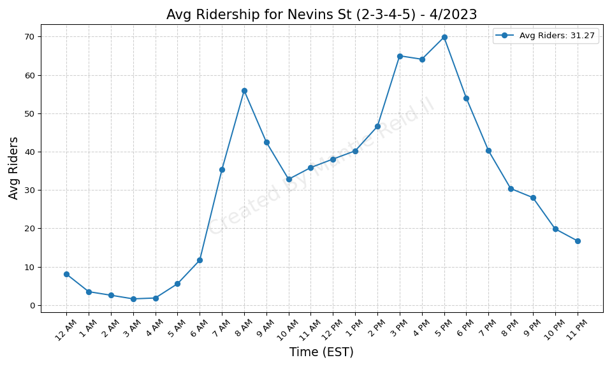
Nevins St (2-3-4-5) - 4/2023

Slide 33
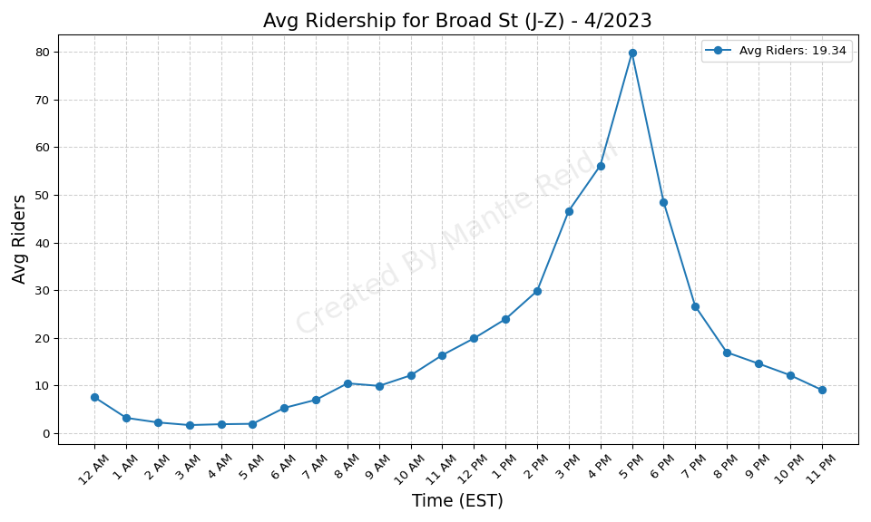
Broad St (J-Z) - 4/2023

Slide 34
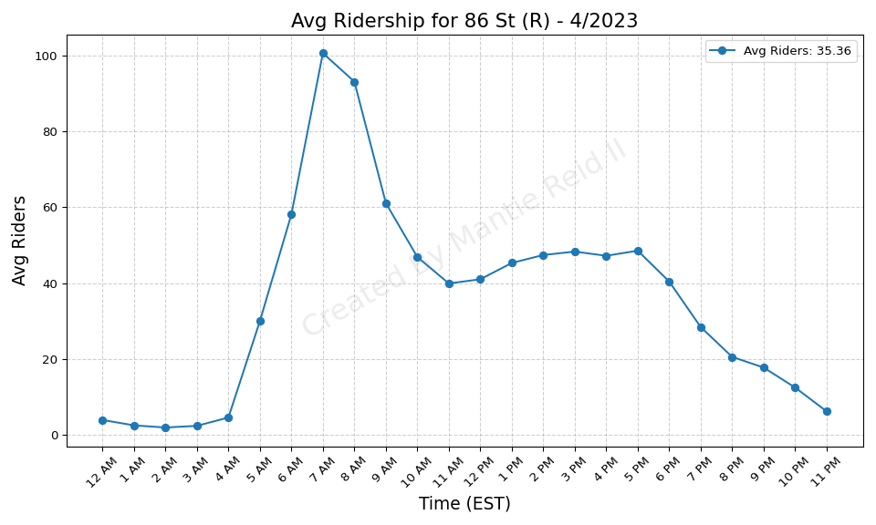
86 St (R) - 4/2023

Slide 35
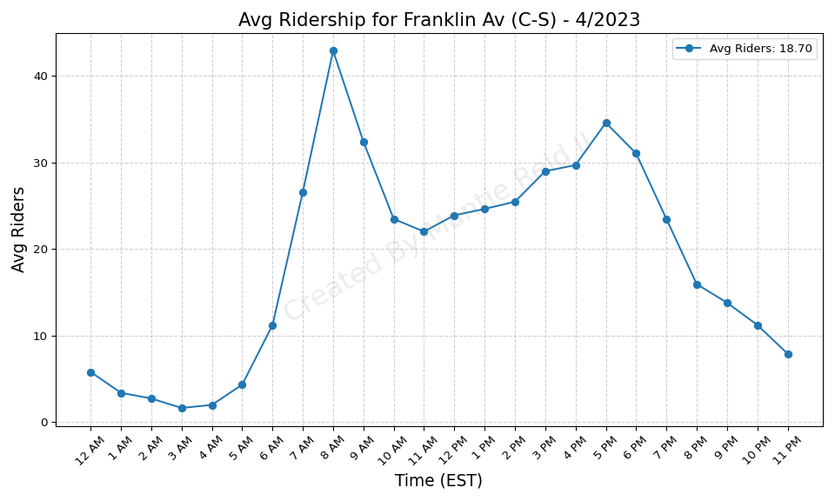
Franklin Av (C-S) - 4/2023

Slide 36
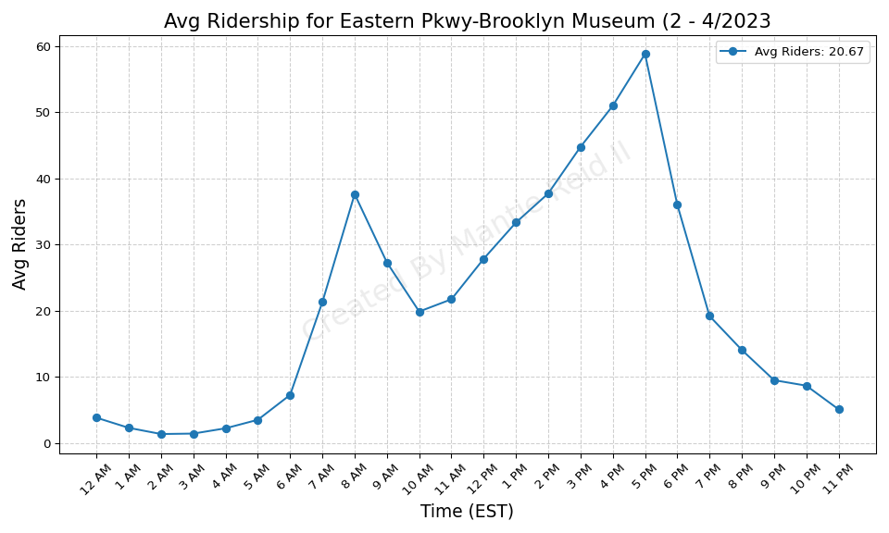
Eastern Pkwy-Brooklyn Museum (2 - 4/2023

Slide 37
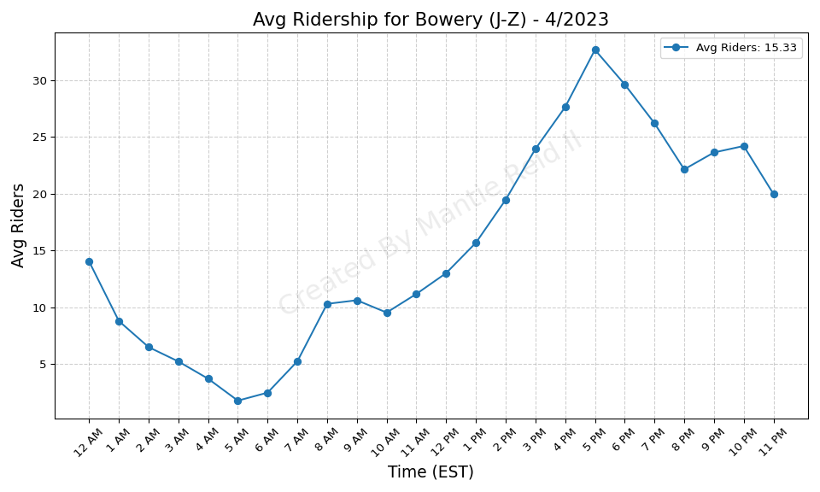
Bowery (J-Z) - 4/2023

Slide 38
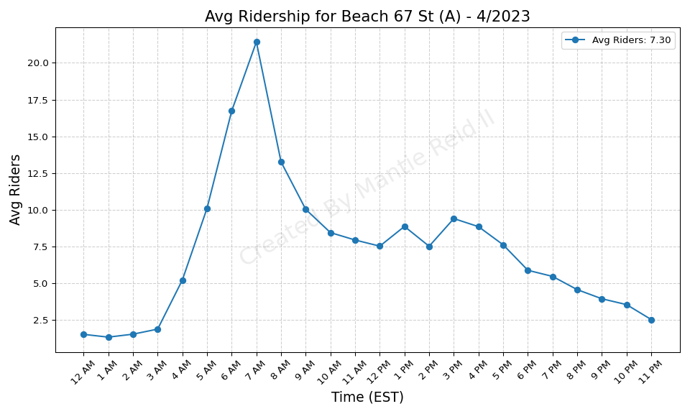
Beach 67 St (A) - 4/2023

Slide 39
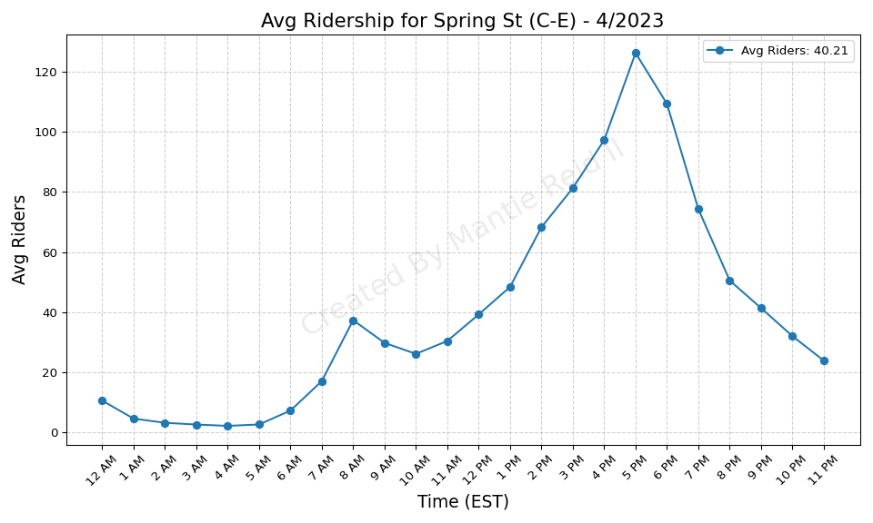
Spring St (C-E) - 4/2023

Slide 40
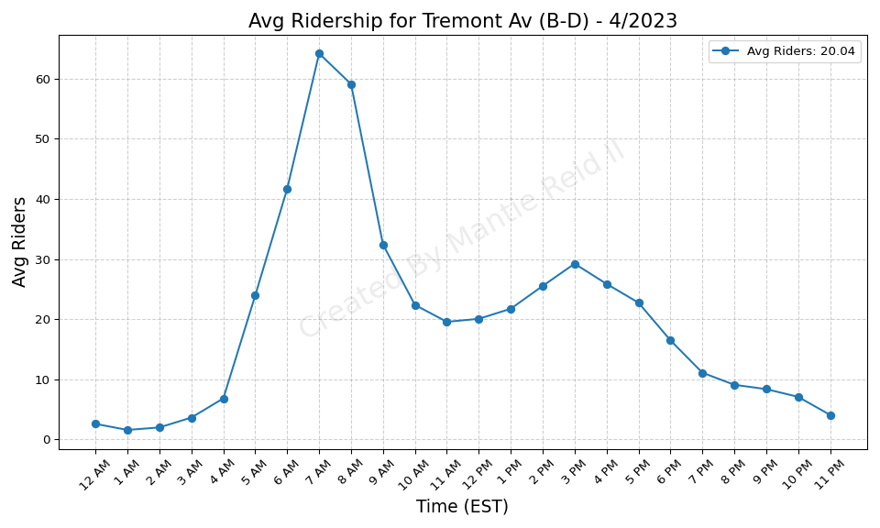
Tremont Av (B-D) - 4/2023

Slide 41
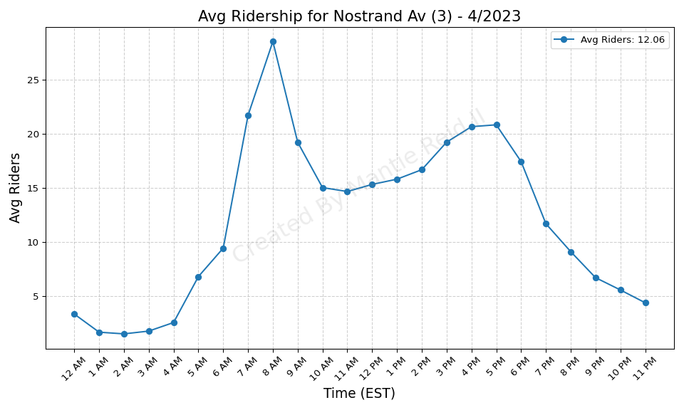
Nostrand Av (3) - 4/2023

Slide 42
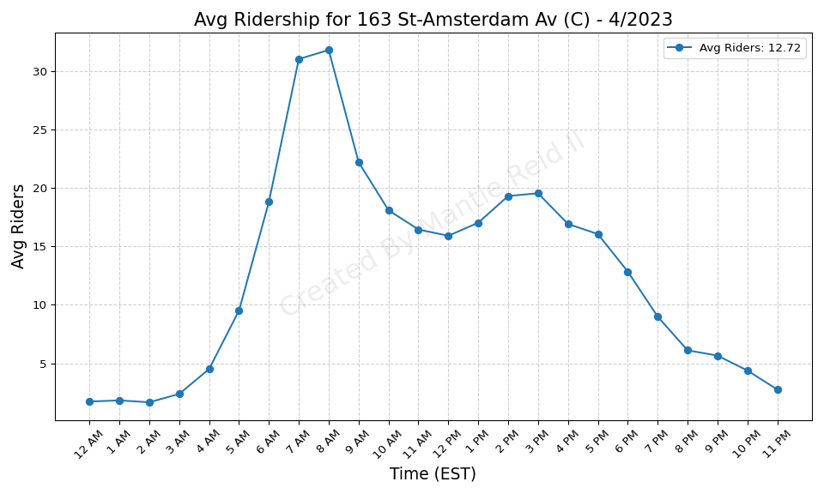
163 St-Amsterdam Av (C) - 4/2023

Slide 43
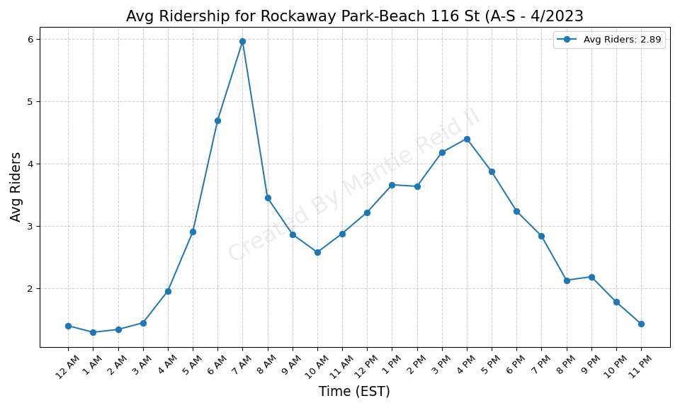
Rockaway Park-Beach 116 St (A-S - 4/2023

Slide 44
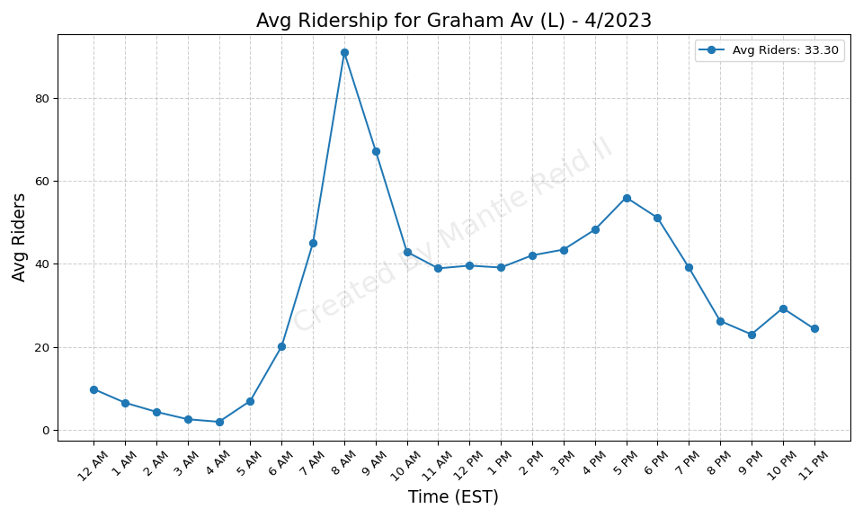
Graham Av (L) - 4/2023

Slide 45
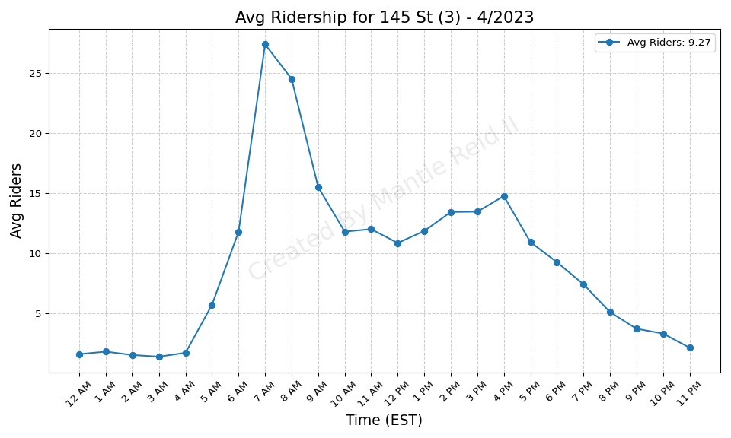
145 St (3) - 4/2023

Slide 46
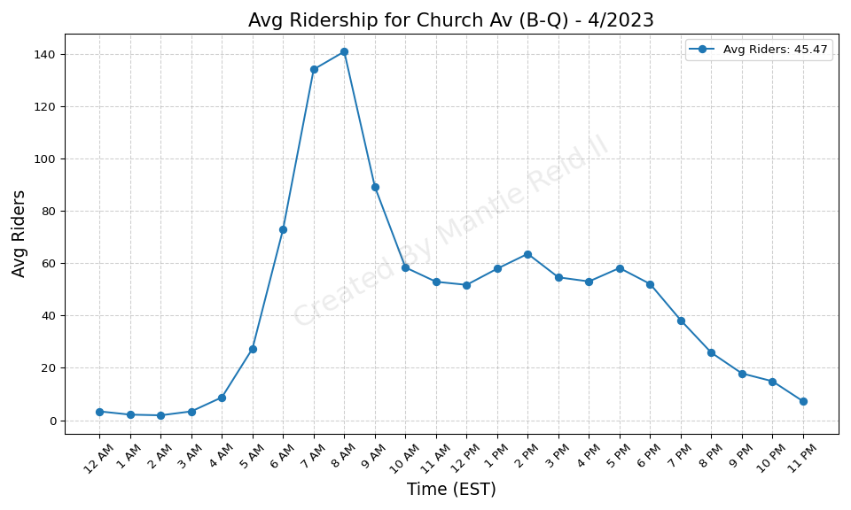
Church Av (B-Q) - 4/2023

Slide 47
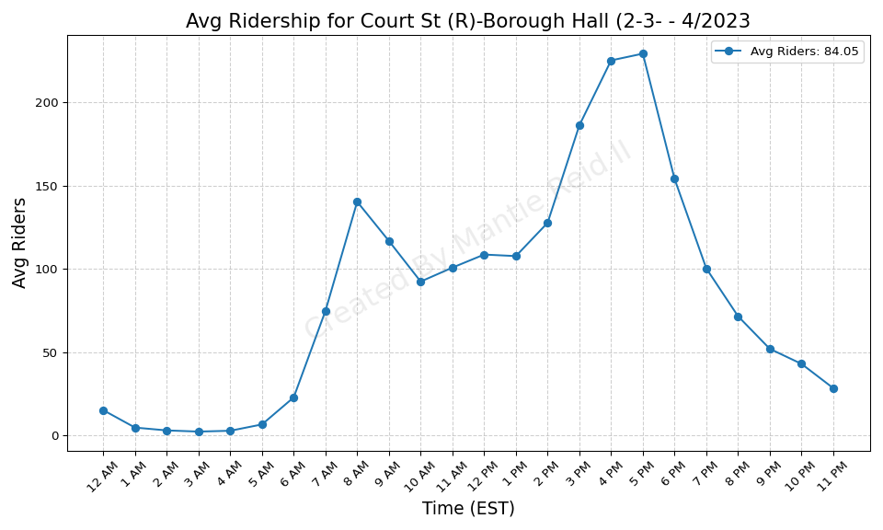
Court St (R)-Borough Hall (2-3- - 4/2023

Slide 48
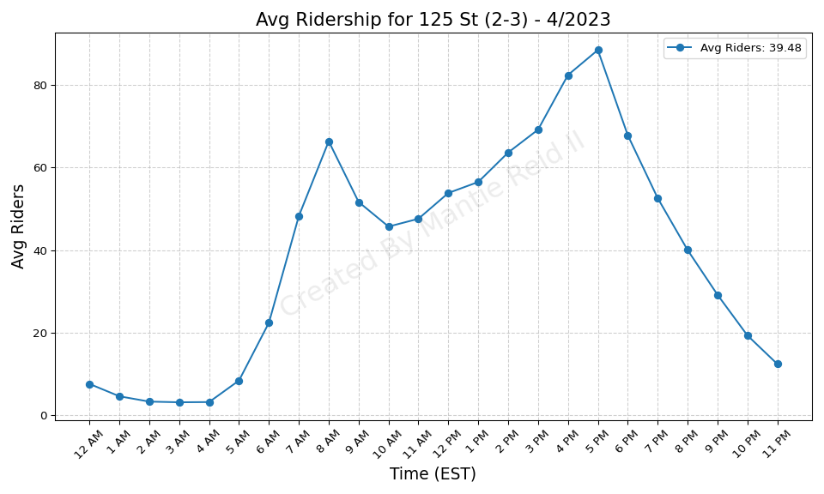
125 St (2-3) - 4/2023

Slide 49
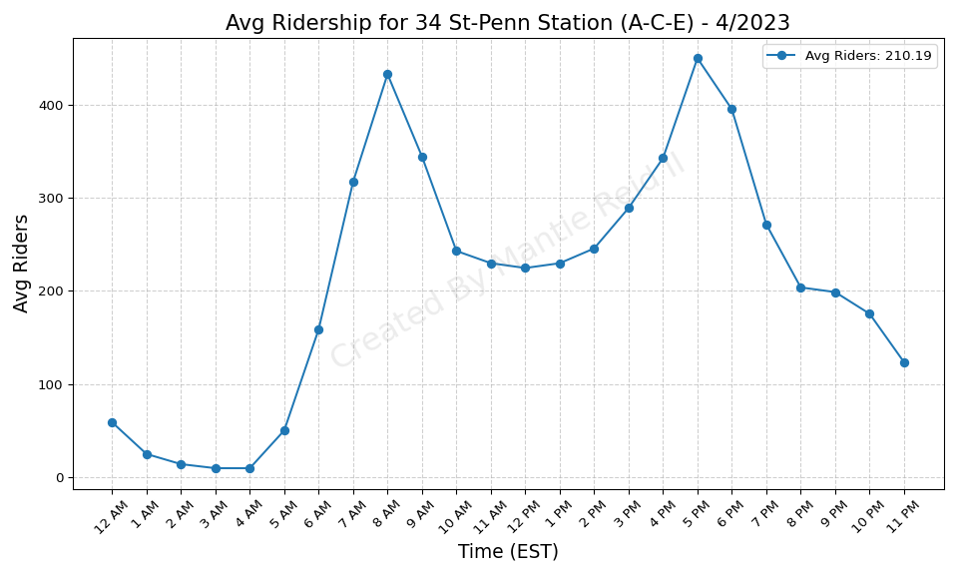
34 St-Penn Station (A-C-E) - 4/2023

Slide 50
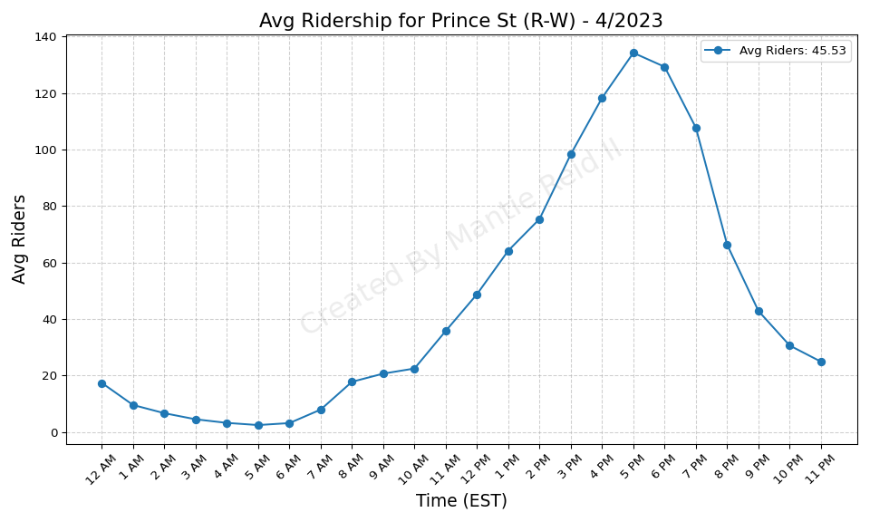
Prince St (R-W) - 4/2023

Slide 51
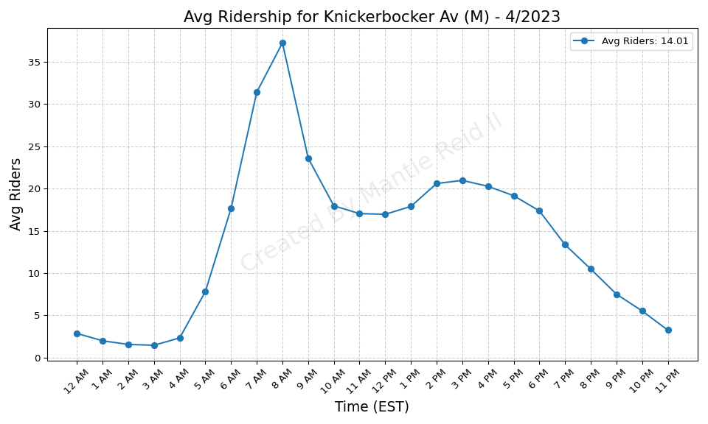
Knickerbocker Av (M) - 4/2023

Slide 52

Lorimer St (M-J) - 4/2023

Slide 53

Cathedral Pkwy (110 St) (C-B) - 4/2023

Slide 54

72 St (C-B) - 4/2023

Slide 55

Kingsbridge Rd (B-D) - 4/2023

Slide 56

Chambers St (A-C)-WTC (E)-Park - 4/2023

Slide 57

Burnside Av (4) - 4/2023

Slide 58

Hewes St (M-J) - 4/2023

Slide 59

Franklin Av (2-3-4-5)-Botanic G - 4/2023

Slide 60

Crown Hts-Utica Av (3-4) - 4/2023

Slide 61

Saratoga Av (3) - 4/2023

Slide 62

135 St (2-3) - 4/2023

Slide 63

Kingston Av (3) - 4/2023

Slide 64

183 St (4) - 4/2023

Slide 65

Mets-Willets Point (7) - 4/2023

Slide 66

Beach 36 St (A) - 4/2023

Slide 67

Seneca Av (M) - 4/2023

Slide 68

Myrtle-Wyckoff Avs (L-M) - 4/2023

Slide 69

Fordham Rd (4) - 4/2023

Slide 70

Astoria-Ditmars Blvd (N-W) - 4/2023

Slide 71

Bay Ridge-95 St (R) - 4/2023

Slide 72

138 St-Grand Concourse (4-5) - 4/2023

Slide 73

Bedford Av (L) - 4/2023

Slide 74

Grand St (L) - 4/2023

Slide 75

Sutter Av-Rutland Rd (3) - 4/2023

Slide 76

W 4 St-Wash Sq (A-C-E-B-D-F-M) - 4/2023

Slide 77

167 St (B-D) - 4/2023

Slide 78

Kingsbridge Rd (4) - 4/2023

Slide 79

Lorimer St (L)-Metropolitan Av - 4/2023

Slide 80

Central Av (M) - 4/2023

Slide 81

South Ferry (1)-Whitehall St (R - 4/2023

Slide 82

Fulton St (A-C-J-Z-2-3-4-5) - 4/2023

Slide 83

182-183 Sts (B-D) - 4/2023

Slide 84

Bedford Park Blvd (B-D) - 4/2023

Slide 85

Brooklyn Bridge-City Hall (4-5- - 4/2023

Slide 86

Woodlawn (4) - 4/2023

Slide 87

125 St (A-C-B-D) - 4/2023

Slide 88

3 Av-138 St (6) - 4/2023

Slide 89

Beach 44 St (A) - 4/2023

Slide 90

Eastchester-Dyre Av (5) - 4/2023

Slide 91

Rector St (R-W) - 4/2023

Slide 92

170 St (B-D) - 4/2023

Slide 93

3 Av-149 St (2-5) - 4/2023

Slide 94

Montrose Av (L) - 4/2023

Slide 95

174-175 Sts (B-D) - 4/2023

Slide 96

Canal St (A-C-E) - 4/2023

Slide 97

Beach 60 St (A) - 4/2023

Slide 98

Middle Village-Metropolitan Av - 4/2023

Slide 99

Beach 25 St (A) - 4/2023

Slide 100

Central Park North (110 St) (2- - 4/2023

Slide 101

103 St (C-B) - 4/2023

Slide 102

RI Tramway (Roosevelt) - 4/2023

Slide 103

81 St-Museum of Natural History - 4/2023

Slide 104

Prospect Av (2-5) - 4/2023

Slide 105

Bergen St (2-3) - 4/2023

Slide 106

8 St-NYU (R-W) - 4/2023

Slide 107

Gun Hill Rd (5) - 4/2023

Slide 108

86 St (C-B) - 4/2023

Slide 109

Marcy Av (M-J-Z) - 4/2023

Slide 110

135 St (C-B) - 4/2023

Slide 111

Bedford Park Blvd-Lehman Colleg - 4/2023

Slide 112

Canal St (J-N-Q-R-W-Z-6) - 4/2023

Slide 113

Norwood-205 St (D) - 4/2023

Slide 114

Jay St-MetroTech (A-C-F-R) - 4/2023

Slide 115

79 St (D) - 4/2023

Slide 116

Jackson Av (2-5) - 4/2023

Slide 117

Mosholu Pkwy (4) - 4/2023

Slide 118

Baychester Av (5) - 4/2023

Slide 119

145 St (A-C-B-D) - 4/2023

Slide 120

Far Rockaway-Mott Av (A) - 4/2023

Slide 121

Broadway Junction (A-C-J-L-Z) - 4/2023

Slide 122

Delancey St (F)-Essex St (J-M-Z - 4/2023

Slide 123

Harlem-148 St (3) - 4/2023

Slide 124

Forest Av (M) - 4/2023

Slide 125

125 St (4-5-6) - 4/2023

Slide 126

170 St (4) - 4/2023

Slide 127

Grand Army Plaza (2-3) - 4/2023

Slide 128

167 St (4) - 4/2023

Slide 129

155 St (B-D) - 4/2023

Slide 130

Fresh Pond Rd (M) - 4/2023

Slide 131

96 St (C-B) - 4/2023

Slide 132

RI Tramway (Manhattan) - 4/2023

Slide 133

116 St (C-B) - 4/2023

Slide 134

21 St-Queensbridge (F) - 4/2023

Slide 135

Intervale Av (2-5) - 4/2023

Slide 136

Rockaway Av (3) - 4/2023

Slide 137

Beach 105 St (A-S) - 4/2023

Slide 138

75 Av (E-F) - 4/2023

Slide 139

York St (F) - 4/2023

Slide 140

28 St (R-W) - 4/2023

Slide 141

Grand Av-Newtown (M-R) - 4/2023

Slide 142

Nostrand Av (A-C) - 4/2023

Slide 143

East Broadway (F) - 4/2023

Slide 144

E 180 St (2-5) - 4/2023

Slide 145

Nereid Av (2-5) - 4/2023

Slide 146

Rockaway Blvd (A) - 4/2023

Slide 147

Utica Av (A-C) - 4/2023

Slide 148

Hoyt-Schermerhorn Sts (A-C-G) - 4/2023

Slide 149

New Lots Av (3) - 4/2023

Slide 150

88 St (A) - 4/2023

Slide 151

Grant Av (A) - 4/2023

Slide 152

St Lawrence Av (6) - 4/2023

Slide 153

77 St (R) - 4/2023

Slide 154

Kew Gardens-Union Tpke (E-F) - 4/2023

Slide 155

Elder Av (6) - 4/2023

Slide 156

Burke Av (2-5) - 4/2023

Slide 157

174 St (2-5) - 4/2023

Slide 158

7 Av (F-G) - 4/2023

Slide 159

Newkirk Av-Little Haiti (2-5) - 4/2023

Slide 160

Lexington Av-63 St (F-Q) - 4/2023

Slide 161

City Hall (R-W) - 4/2023

Slide 162

67 Av (M-R) - 4/2023

Slide 163

Livonia Av (L) - 4/2023

Slide 164

Grand St (B-D) - 4/2023

Slide 165

Woodhaven Blvd (M-R) - 4/2023

Slide 166

Morrison Av-Soundview (6) - 4/2023

Slide 167

Rockaway Av (C) - 4/2023

Slide 168

Jefferson St (L) - 4/2023

Slide 169

Euclid Av (A-C) - 4/2023

Slide 170

Ozone Park-Lefferts Blvd (A) - 4/2023

Slide 171

Allerton Av (2-5) - 4/2023

Slide 172

Northern Blvd (M-R) - 4/2023

Slide 173

Atlantic Av (L) - 4/2023

Slide 174

57 St (F) - 4/2023

Slide 175

Hunts Point Av (6) - 4/2023

Slide 176

47-50 Sts-Rockefeller Ctr (B-D- - 4/2023

Slide 177

Park Pl (S) - 4/2023

Slide 178

President St-Medgar Evers Colle - 4/2023

Slide 179

Dyckman St (A) - 4/2023

Slide 180

80 St (A) - 4/2023

Slide 181

Morgan Av (L) - 4/2023

Slide 182

Pelham Pkwy (2-5) - 4/2023

Slide 183

219 St (2-5) - 4/2023

Slide 184

Bushwick Av-Aberdeen St (L) - 4/2023

Slide 185

65 St (M-R) - 4/2023

Slide 186

Liberty Av (C) - 4/2023

Slide 187

Steinway St (M-R) - 4/2023

Slide 188

Kingston-Throop Avs (C) - 4/2023

Slide 189

233 St (2-5) - 4/2023

Slide 190

Shepherd Av (C) - 4/2023

Slide 191

Westchester Sq-E Tremont Av (6) - 4/2023

Slide 192

Astoria Blvd (N-W) - 4/2023

Slide 193

Beach 90 St (A-S) - 4/2023

Slide 194

Middletown Rd (6) - 4/2023

Slide 195

Parkside Av (Q) - 4/2023

Slide 196

Inwood-207 St (A) - 4/2023

Slide 197

DeKalb Av (L) - 4/2023

Slide 198

Church Av (2-5) - 4/2023

Slide 199

Van Siclen Av (3) - 4/2023

Slide 200

111 St (A) - 4/2023

Slide 201

Cypress Av (6) - 4/2023

Slide 202

23 St (F-M) - 4/2023

Slide 203

Smith-9 Sts (F-G) - 4/2023

Slide 204

Longwood Av (6) - 4/2023

Slide 205

Bronx Park East (2-5) - 4/2023

Slide 206

Simpson St (2-5) - 4/2023

Slide 207

63 Dr-Rego Park (M-R) - 4/2023

Slide 208

Prospect Park (B-Q-S) - 4/2023

Slide 209

Parkchester (6) - 4/2023

Slide 210

Pennsylvania Av (3) - 4/2023

Slide 211

Brook Av (6) - 4/2023

Slide 212

West Farms Sq-E Tremont Av (2-5 - 4/2023

Slide 213

Bergen St (F-G) - 4/2023

Slide 214

Wakefield-241 St (2) - 4/2023

Slide 215

Aqueduct Racetrack (A) - 4/2023

Slide 216

Whitlock Av (6) - 4/2023

Slide 217

Freeman St (2-5) - 4/2023

Slide 218

Flatbush Av-Brooklyn College (2 - 4/2023

Slide 219

Clinton-Washington Avs (C) - 4/2023

Slide 220

46 St (M-R) - 4/2023

Slide 221

Junius St (3) - 4/2023

Slide 222

Zerega Av (6) - 4/2023

Slide 223

Roosevelt Island (F) - 4/2023

Slide 224

E 143 St-St Mary-s St (6) - 4/2023

Slide 225

2 Av (F) - 4/2023

Slide 226

59 St (N-R) - 4/2023

Slide 227

Wilson Av (L) - 4/2023

Slide 228

Forest Hills-71 Av (E-F-M-R) - 4/2023

Slide 229

Queens Plaza (E-M-R) - 4/2023

Slide 230

Broad Channel (A-S) - 4/2023

Slide 231

Van Siclen Av (C) - 4/2023

Slide 232

East 105 St (L) - 4/2023

Slide 233

36 St (M-R) - 4/2023

Slide 234

Beach 98 St (A-S) - 4/2023

Slide 235

Aqueduct-N Conduit Av (A) - 4/2023

Slide 236

Castle Hill Av (6) - 4/2023

Slide 237

Halsey St (L) - 4/2023

Slide 238

E 149 St (6) - 4/2023

Slide 239

Winthrop St (2-5) - 4/2023

Slide 240

DeKalb Av (B-Q-R) - 4/2023

Slide 241

15 St-Prospect Park (F-G) - 4/2023

Slide 242

Sterling St (2-5) - 4/2023

Slide 243

Carroll St (F-G) - 4/2023

Slide 244

23 St (R-W) - 4/2023

Slide 245

225 St (2-5) - 4/2023

Slide 246

Pelham Bay Park (6) - 4/2023

Slide 247

Bay Ridge Av (R) - 4/2023

Slide 248

Lafayette Av (C) - 4/2023

Slide 249

Gun Hill Rd (2-5) - 4/2023

Slide 250

Canarsie-Rockaway Pkwy (L) - 4/2023

Slide 251

New Lots Av (L) - 4/2023

Slide 252

Howard Beach-JFK Airport (A) - 4/2023

Slide 253

Buhre Av (6) - 4/2023

Slide 254

Beverly Rd (2-5) - 4/2023

Slide 255

Elmhurst Av (M-R) - 4/2023

Slide 256

Briarwood (E-F) - 4/2023

Slide 257

145 St (1) - 4/2023

Slide 258

191 St (1) - 4/2023

Slide 259

69 St (7) - 4/2023

Slide 260

238 St (1) - 4/2023

Slide 261

231 St (1) - 4/2023

Slide 262

86 St (Q) - 4/2023

Slide 263

Astor Pl (6) - 4/2023

Slide 264

33 St (6) - 4/2023

Slide 265

23 St (1) - 4/2023

Slide 266

Union St (R) - 4/2023

Slide 267

215 St (1) - 4/2023

Slide 268

103 St (6) - 4/2023

Slide 269

Avenue U (Q) - 4/2023

Slide 270

Avenue P (F) - 4/2023

Slide 271

18 Av (F) - 4/2023

Slide 272

Canal St (1) - 4/2023

Slide 273

Avenue I (F) - 4/2023

Slide 274

Avenue H (Q) - 4/2023

Slide 275

Kings Hwy (F) - 4/2023

Slide 276

Fulton St (G) - 4/2023

Slide 277

86 St (1) - 4/2023

Slide 278

Kings Hwy (B-Q) - 4/2023

Slide 279

181 St (1) - 4/2023

Slide 280

Cortelyou Rd (Q) - 4/2023

Slide 281

Beverley Rd (Q) - 4/2023

Slide 282

79 St (1) - 4/2023

Slide 283

23 St (6) - 4/2023

Slide 284

Prospect Av (R) - 4/2023

Slide 285

30 Av (N-W) - 4/2023

Slide 286

169 St (F) - 4/2023

Slide 287

Sutphin Blvd (F) - 4/2023

Slide 288

Greenpoint Av (G) - 4/2023

Slide 289

61 St-Woodside (7) - 4/2023

Slide 290

33 St-Rawson St (7) - 4/2023

Slide 291

68 St-Hunter College (6) - 4/2023

Slide 292

Vernon Blvd-Jackson Av (7) - 4/2023

Slide 293

Cathedral Pkwy (110 St) (1) - 4/2023

Slide 294

Myrtle-Willoughby Avs (G) - 4/2023

Slide 295

St George (SIR) - 4/2023

Slide 296

Clinton-Washington Avs (G) - 4/2023

Slide 297

50 St (1) - 4/2023

Slide 298

34 St-Penn Station (1-2-3) - 4/2023

Slide 299

Dyckman St (1) - 4/2023

Slide 300

Parsons Blvd (F) - 4/2023

Slide 301

72 St (1-2-3) - 4/2023

Slide 302

Ocean Pkwy (Q) - 4/2023

Slide 303

52 St (7) - 4/2023

Slide 304

110 St (6) - 4/2023

Slide 305

Houston St (1) - 4/2023

Slide 306

5 Av-53 St (E-M) - 4/2023

Slide 307

36 Av (N-W) - 4/2023

Slide 308

Avenue N (F) - 4/2023

Slide 309

207 St (1) - 4/2023

Slide 310

Queensboro Plaza (7-N-W) - 4/2023

Slide 311

46 St-Bliss St (7) - 4/2023

Slide 312

90 St-Elmhurst Av (7) - 4/2023

Slide 313

Christopher St-Sheridan Sq (1) - 4/2023

Slide 314

96 St (6) - 4/2023

Slide 315

103 St-Corona Plaza (7) - 4/2023

Slide 316

Van Cortlandt Park-242 St (1) - 4/2023

Slide 317

111 St (7) - 4/2023

Slide 318

Broadway (G) - 4/2023

Slide 319

103 St (1) - 4/2023

Slide 320

Hunters Point Av (7) - 4/2023

Slide 321

36 St (D-N-R) - 4/2023

Slide 322

Wall St (4-5) - 4/2023

Slide 323

28 St (6) - 4/2023

Slide 324

28 St (1) - 4/2023

Slide 325

157 St (1) - 4/2023

Slide 326

Nassau Av (G) - 4/2023

Slide 327

Jamaica Center-Parsons-Archer ( - 4/2023

Slide 328

Bryant Pk (B-D-F-M)-5 Av (7) - 4/2023

Slide 329

Bedford-Nostrand Avs (G) - 4/2023

Slide 330

82 St-Jackson Hts (7) - 4/2023

Slide 331

Junction Blvd (7) - 4/2023

Slide 332

Jamaica-179 St (F) - 4/2023

Slide 333

Jamaica-Van Wyck (E) - 4/2023

Slide 334

Neck Rd (Q) - 4/2023

Slide 335

137 St-City College (1) - 4/2023

Slide 336

Bay Pkwy (F) - 4/2023

Slide 337

Avenue J (Q) - 4/2023

Slide 338

Classon Av (G) - 4/2023

Slide 339

Newkirk Plaza (B-Q) - 4/2023

Slide 340

96 St (1-2-3) - 4/2023

Slide 341

Neptune Av (F) - 4/2023

Slide 342

Broadway (N-W) - 4/2023

Slide 343

Avenue X (F) - 4/2023

Slide 344

Sutphin Blvd-Archer Av-JFK Airp - 4/2023

Slide 345

7 Av (E-B-D) - 4/2023

Slide 346

96 St (Q) - 4/2023

Slide 347

Tompkinsville (SIR) - 4/2023

Slide 348

66 St-Lincoln Center (1) - 4/2023

Slide 349

18 St (1) - 4/2023

Slide 350

Flushing Av (G) - 4/2023

Slide 351

77 St (6) - 4/2023

Slide 352

116 St-Columbia University (1) - 4/2023

Slide 353

Marble Hill-225 St (1) - 4/2023

Slide 354

Fort Hamilton Pkwy (F-G) - 4/2023

Slide 355

86 St (4-5-6) - 4/2023

Slide 356

40 St-Lowery St (7) - 4/2023

Slide 357

72 St (Q) - 4/2023

Slide 358

7 Av (B-Q) - 4/2023

Slide 359

Brighton Beach (B-Q) - 4/2023

Slide 360

Ditmas Av (F) - 4/2023

Slide 361

Church Av (F-G) - 4/2023

Slide 362

Avenue U (F) - 4/2023

Slide 363

Sheepshead Bay (B-Q) - 4/2023

Slide 364

34 St-Hudson Yards (7) - 4/2023

Slide 365

125 St (1) - 4/2023

Slide 366

25 St (R) - 4/2023

Slide 367

Spring St (6) - 4/2023

Slide 368

Bowling Green (4-5) - 4/2023

Slide 369

21 St (G) - 4/2023

Slide 370

Avenue M (Q) - 4/2023

Slide 371

8 Av (N) - 4/2023

Slide 372

25 Av (D) - 4/2023

Slide 373

9 Av (D) - 4/2023

Slide 374

50 St (D) - 4/2023

Slide 375

20 Av (N) - 4/2023

Slide 376

Gates Av (J-Z) - 4/2023

Slide 377

Bay Pkwy (N) - 4/2023

Slide 378

86 St (N) - 4/2023

Slide 379

Halsey St (J) - 4/2023

Slide 380

Bay 50 St (D) - 4/2023

Slide 381

Alabama Av (J) - 4/2023

Slide 382

Broadway-Lafayette St (B-D-F-M) - 4/2023

Slide 383

Norwood Av (J-Z) - 4/2023

Slide 384

Lexington Av-53 St (E-M)-51 St - 4/2023

Slide 385

Lexington Av (N-R-W)-59 St (4-5 - 4/2023

Slide 386

Coney Island-Stillwell Av (D-F- - 4/2023

Slide 387

Fort Hamilton Pkwy (D) - 4/2023

Slide 388

4 Av (F-G)-9 St (R) - 4/2023

Slide 389

39 Av-Dutch Kills (N-W) - 4/2023

Slide 390

Kosciuszko St (J) - 4/2023

Slide 391

55 St (D) - 4/2023

Slide 392

85 St-Forest Pkwy (J) - 4/2023

Slide 393

Bay Pkwy (D) - 4/2023

Slide 394

Crescent St (J-Z) - 4/2023

Slide 395

New Utrecht Av (N)-62 St (D) - 4/2023

Slide 396

Atlantic Av-Barclays Ctr (B-D-N - 4/2023

Slide 397

59 St-Columbus Circle (A-B-C-D- - 4/2023

Slide 398

20 Av (D) - 4/2023

Slide 399

Van Siclen Av (J-Z) - 4/2023

Slide 400

18 Av (D) - 4/2023

Slide 401

14 St (F-M-1-2-3)-6 Av (L) - 4/2023

Slide 402

18 Av (N) - 4/2023

Slide 403

Kings Hwy (N) - 4/2023

Slide 404

74-Broadway (7)-Jackson Hts-Roo - 4/2023

Slide 405

57 St-7 Av (N-Q-R-W) - 4/2023

Slide 406

Chauncey St (J-Z) - 4/2023

Slide 407

104 St (J-Z) - 4/2023

Slide 408

Avenue U (N) - 4/2023

Slide 409

14 St (A-C-E)-8 Av (L) - 4/2023

Slide 410

168 St (A-C-1) - 4/2023

Slide 411

149 St-Grand Concourse (2-4-5) - 4/2023

Slide 412

75 St-Elderts Ln (J-Z) - 4/2023

Slide 413

W 8 St-NY Aquarium (F-Q) - 4/2023

Slide 414

Court Sq (E-G-M-7) - 4/2023

Slide 415

14 St-Union Sq (L-N-Q-R-W-4-5-6 - 4/2023

Slide 416

34 St-Herald Sq (B-D-F-M-N-Q-R- - 4/2023

Slide 417

Grand Central-42 St (S-4-5-6-7) - 4/2023

Slide 418

Myrtle Av (M-J-Z) - 4/2023

Slide 419

121 St (J-Z) - 4/2023

Slide 420

161 St-Yankee Stadium (B-D-4) - 4/2023

Slide 421

Flushing Av (M-J) - 4/2023

Slide 422

Woodhaven Blvd (J-Z) - 4/2023

Slide 423

111 St (J) - 4/2023

Slide 424

Cypress Hills (J) - 4/2023

Slide 425

Fort Hamilton Pkwy (N) - 4/2023

Slide 426

Times Sq-42 St (N-Q-R-W-S-1-2-3 - 4/2023

Slide 427

5 Av-59 St (N-R-W) - 4/2023

Slide 428

Cleveland St (J) - 4/2023

